Slide 1
تصميم آلات ومعدات زراعية عملي المحاضرة (3)
قسم المكائن: المرحلة الثالثة
م. فرقد مرتضى الموسوي

Slide 2
Standardization
Standardization is defined as obligatory (or compulsory) norms, to which various characteristics of a product should comply (or agree) with standard.
The characteristics include materials, dimensions and shape of the component, method of testing and method of marking, packing and storing of the product.

Slide 3
A standard is defined as a set of specifications for parts, materials or processes. The objective of, a standard is to reduce the variety and limit the number of items to a reasonable level.
On the other hand, a code is defined as a set of specifications for the analysis, design, manufacture, testing and erection of the product. The purpose of a code is to achieve a specified level of safety.

Slide 4
There are three types of standards used in design :-
Company Standards: They are used in a particular company or a group of sister concerns.
National standards:
– India - BIS (Bureau of Indian Standards),
– Germany - DIN (Deutsches Institut für Normung),
– USA - AISI (American Iron and Steel Institute) or SAE (Society of Automotive Engineers), – UK - BS (British Standards)
International standards: These are prepared by the International Standards Organization (ISO).

Slide 5
Standards for Materials, their chemical compositions, Mechanical properties and Heat Treatment:
For example, Indian standard IS 210 specifies seven grades of grey cast iron designated as FG 150, FG 200, FG 220, FG 260, FG 300, FG 350 and FG 400. The number indicates ultimate tensile strength in N/mm².
Standards for Shapes and dimensions of commonly used Machine Elements:
The machine elements include bolts, screws and nuts, rivets, belts and chains, ball and roller bearings, wire ropes, keys and splines, etc.
For example, IS 2494 (Part 1) specifies dimensions and shape of the cross- section of endless V-belts for power transmission.
The dimensions of the trapezoidal cross-section of the belt, viz. width, height and included angle are specified in this standard.

Slide 6
Standards for Fits, Tolerances and Surface Finish of Component:
For example, selection of the type of fit for different applications is illustrated in IS 2709 on 'Guide for selection of fits'.
The tolerances or upper and lower limits for various sizes of holes and shafts are specified in IS 919 on 'Recommendations for limits and fits for engineering'.
IS 10719 explains method for indicating surface texture on technical drawings.

Slide 7
Standards for Testing of Products:
These standards, sometimes called 'codes', give procedures to test the products such as pressure vessel, boiler, crane and wire rope, where safety of the operator is an important consideration.
For example, IS 807 is a code of practice for design, manufacture, erection and testing of cranes and hoists.

Slide 8
Benefits of Standardization
Reductions in types and dimensions of identical components (inventory control).
Reduction in manufacturing facilities.
Easy to replace (Interchangeability).
No need to design or test the elements.
Improves quality and reliability.
Improves reputation of the company which manufactures standard components.
Sometimes it ensures the safety.
It results in overall cost reduction.

Slide 9
Preferred Numbers
With the acceptance of standardization, there is a need to keep the standard sizes or dimensions of any component or product in discrete steps.
The sizes should be spread over the wide range, at the same time these should be spaced properly.
For example, if shaft diameters are to be standardized between 10 mm and 25 mm, then sizes should be like : 10 mm, 12.5 mm, 15 mm, 20 mm, 25 mm and not like : 10 mm, 11 mm, 13 mm, 18 mm, 25 mm.
This led to the use of geometric series known as series of preferred numbers or preferred series.
Preferred series are series of numbers obtained by geometric progression and rounded off.

Slide 10
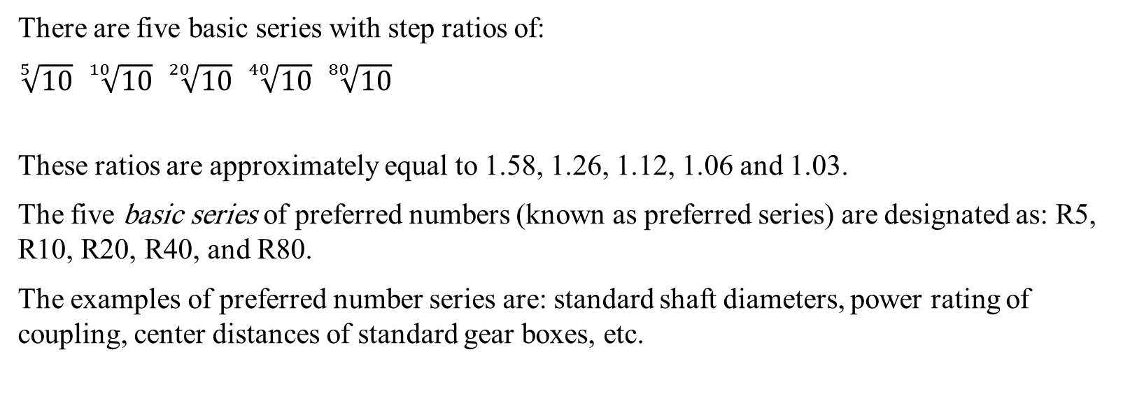
There are five basic series with step ratios of:
$\sqrt[5]{10}$ $\sqrt[10]{10}$ $\sqrt[20]{10}$ $\sqrt[40]{10}$ $\sqrt[80]{10}$
These ratios are approximately equal to 1.58, 1.26, 1.12, 1.06 and 1.03.
The five basic series of preferred numbers (known as preferred series) are designated as: R5, R10, R20, R40, and R80.
The examples of preferred number series are: standard shaft diameters, power rating of coupling, center distances of standard gear boxes, etc.

Slide 11
Advantages Preferred Numbers
The difference in two successive terms has a fixed percentage.
It provides small steps for small quantities and large steps for large quantities.
The product range is covered with minimum number of sizes without restricting the choice of the customers.

